Slide 1

Sheton , Tarik, Benjamin

Slide 2

Project Overview
Research Question
What are the factors that lead to a successful marriage and do they actually make a difference?
Objective
To use data that demonstrates success in a marriage comes with multiple different aspects.

Slide 3


Background
There are many factors that can be considered in what creates a successful marriage
We narrowed it down to three.
Educational attainment
Employment status
Race (Black and White)

Slide 4
Research
One of the biggest reasons why a couple gets a divorce is due to the man’s employment status
According to Herston Law Group, since 1975 everything has changed about divorce except for one thing
That one thing is how the man spends his time

Slide 5
Research
Studies have shown that for a long time people with a college degree are more likely to have a successful marriage than people with less
Most believe that it is because of the potential and the value that a degree brings

Slide 6
Research
Many different cultures view marriage differently
In America, foreigners are more likely to have a successful marriage than people who were born here
It is very hard to determine what can create a successful marriage if we don’t separate the different races

Slide 7
Data Used
We used data from The ACS
Our data range is a group of 50,000 people throughout the entire nation
We used data from the year 2019

Slide 8
Data Wrangling Techniques
There were missing entries in one of our data sets
We narrowed the racial status to black and white due to missing information and the outstanding number of people.
We didn’t require any other wrangling due to the factors that we chose and organization of ACS

Slide 9
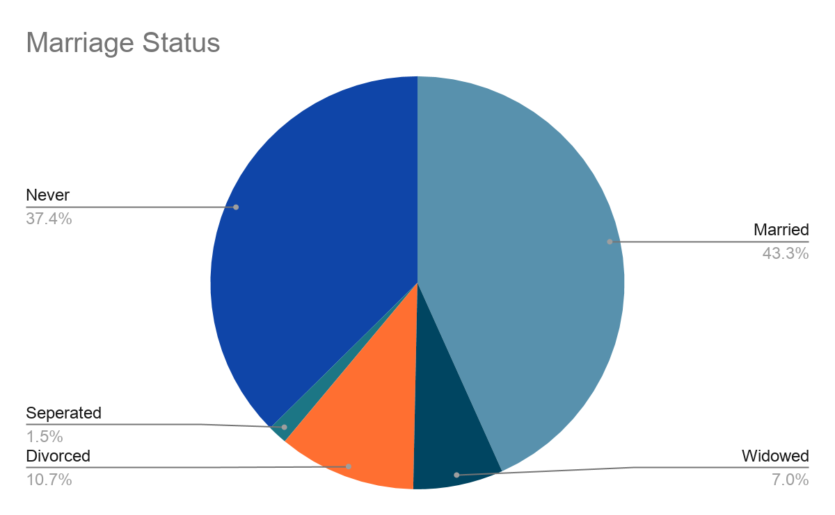
Pie Charts

Slide 10
Results
79% of people in the US as of 2019 that were employed had a successful marriage
Most US citizens’ highest level of education is a high school diploma
73% of these people had a successful marriage in 2019
However, people with a master’s degree had the highest successful marriage rate in 2019 which is 85%
78% of white people in 2019 had a successful marriage
54% of black people in 2019 had a successful marriage

Slide 11
Conclusion
There are many factors that can create a successful marriage, but after heavy research we narrowed it down to three:
Employment status
Race
Educational attainment
People who are employed have the highest chances of attaining a successful marriage
People with a master’s degree have the highest chance of attaining a successful marriage
White people have the highest chance of attaining a successful marriage

